Slide 1
Online Retail Analysis and Insights
Presented by: Lingam

Slide 2
Today’s agenda
Project Recap
Problem Statement
Task Performed
Analysis Process
Key Insights
Insights and Summary

Slide 3
Project Recap
Objective: Analyze the store’s data to identify revenue drivers and strategic opportunities for expansion.
Stakeholders: CEO and CMO
Tools Used: Excel, Power BI
Focus Areas:
Revenue trends
Top-performing regions and customers
Opportunities for repeat business and product demand

Slide 4
Problem Statement
Problem Statements:
The Leadership team seeks insight on:
Factors driving revenue.
2. Seasonal and geographical trends.
3. Key customers segments and their contribution.
4. Opportunities for expansion and improved marketing strategies.

Slide 5
Task Performed
Task Performed involved:
Data Cleaning:
Removed negative quantities and incorrect unit prices.
Filtered data for valid transactions.
Revenue Calculation:
Formula: Quantity x Unit Price.
Visualizations Created:
2011 Monthly Revenue - Line Chart.
Top 10 Countries – Cluster Column Chart.
Top 10 Customers – Cluster Column Chart.
Global Sales - Map Chart.

Slide 6
Analysis Process
Analysis Process Involved:
Loaded Data.
Identified and resolved data quality issues.
Applied data transformation to ensure analysis
accuracy.
4. Developed visuals tailored to stakeholder
questions:
Time Series Analysis
Bar, Map and Distribution Charts.
5. Derived actionable from visualization Patterns.

Slide 7
Key Insights for
CEO & CMO
Key Insights For CEO:
Monthly Revenue Trends.
Geographical Demand.
Key Insights For CMO:
1.Top 10 Customers.
2.Top 10 Countries.

Slide 8
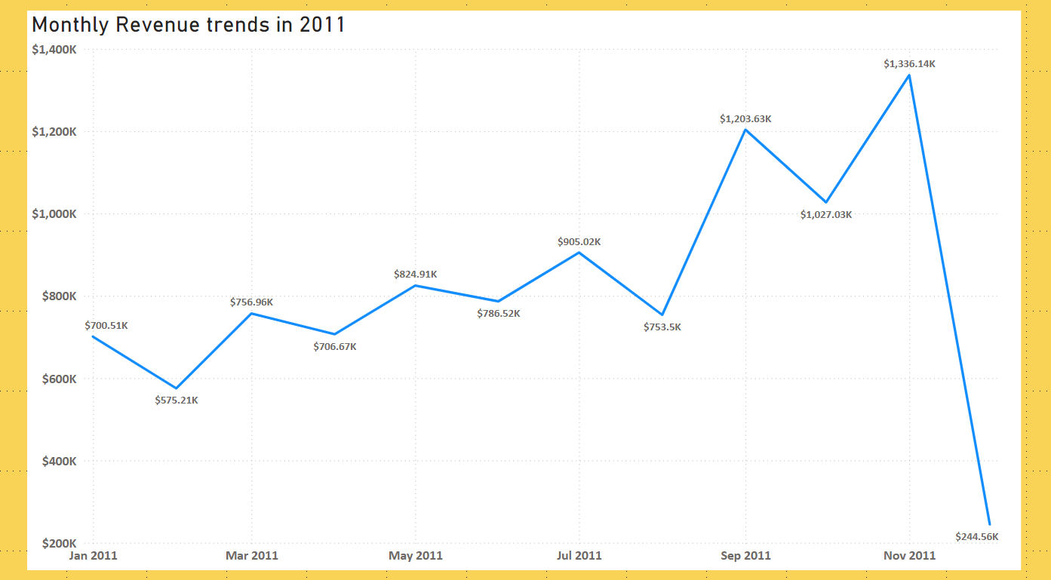
Monthly Revenue Trends

Slide 9
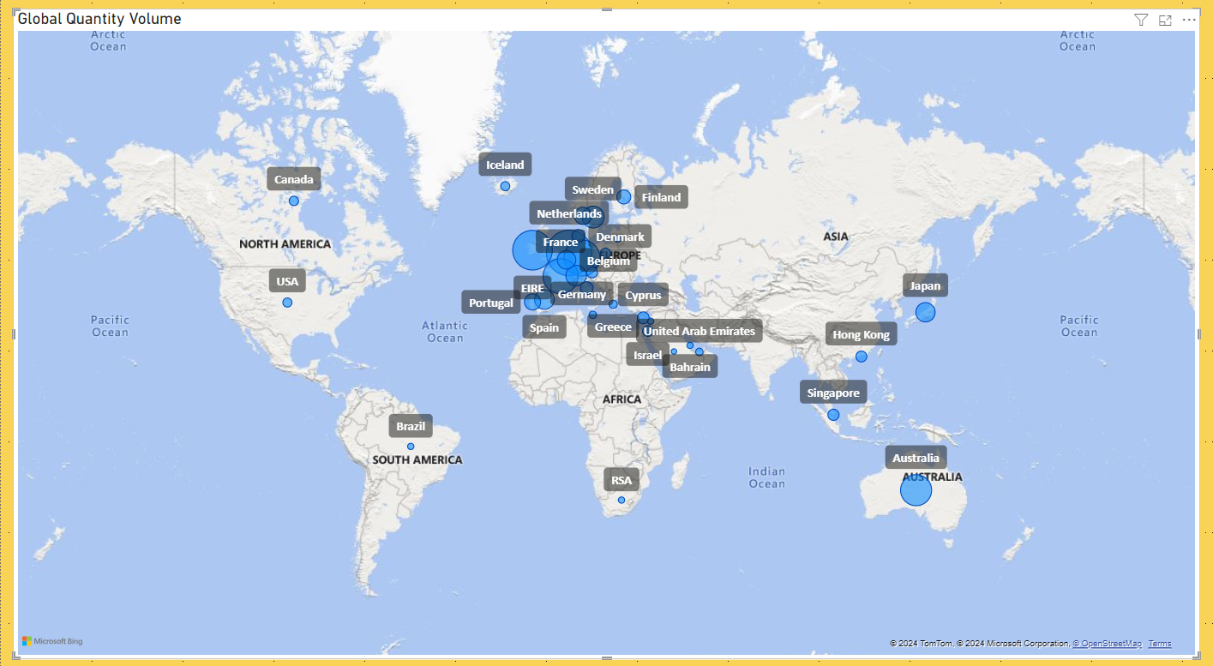
Geographical Demand

Slide 10
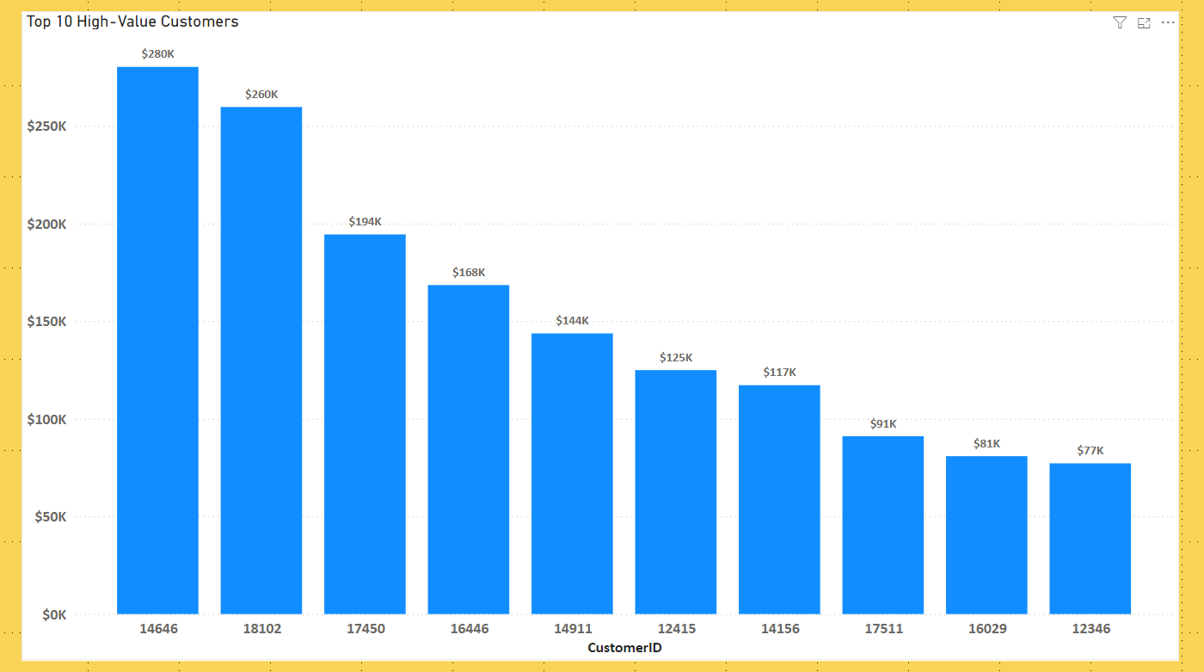
Top 10 Customers

Slide 11
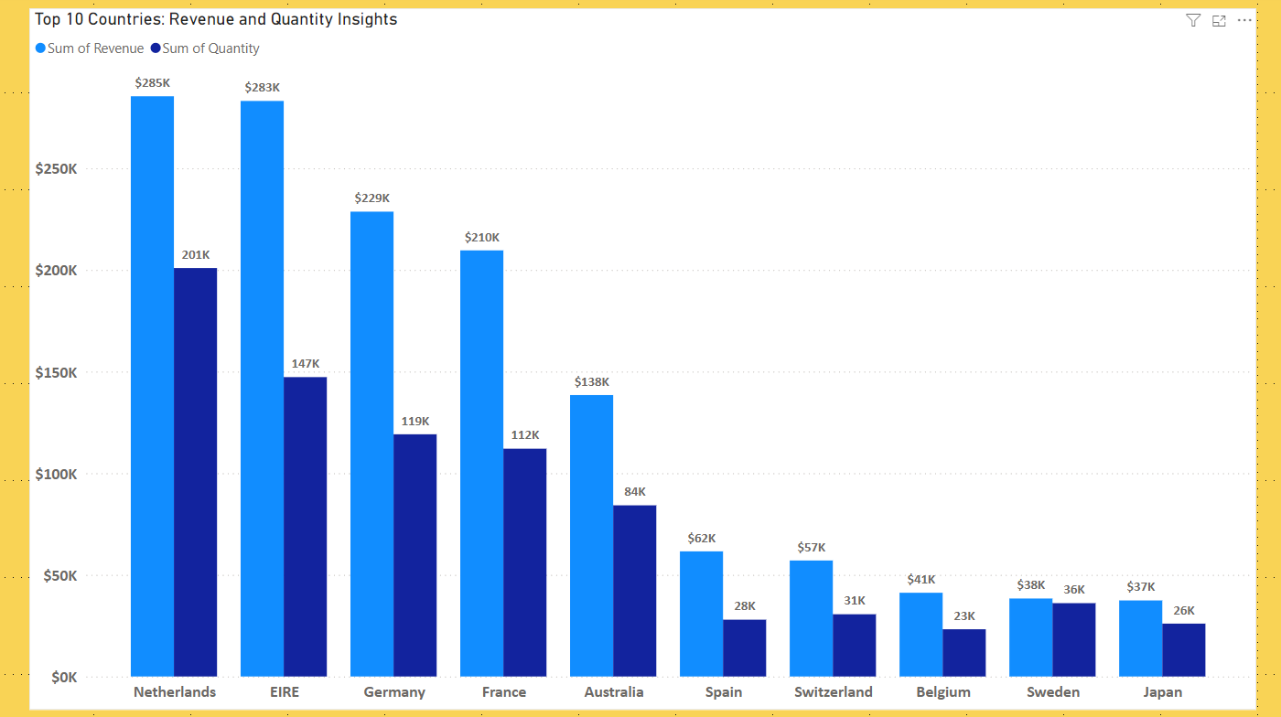
Top 10 Countries Insights

Slide 12
Summary and
Recommendations
Summary and Recommendations:
Summary:
1.Seasonal revenue trends and top performing regions identified.
2. High-value customers are key revenue drivers.
Recommendations:
Optimize Seasonal Strategies.
Focus on Repeat Customers.
Regional Expansion.
Diversify Customer Base.

Slide 13
Thank you!
Questions and next step

